Slide 1
Good, Great, Excellent Quality Reviews of Amazon Electronics
J. Garrecht Metzger
(Metis Winter Cohort 2021)

Slide 2
Inspiration for study?
Amazon organizes its own categories of Electronics

Slide 3
Inspiration for study?
Amazon organizes its own categories of Electronics
What might unsupervised Natural Language Processing tell us about how reviews discuss actual electronics products Amazon sells?

Slide 4
Inspiration for study?
Amazon organizes its own categories of Electronics
What might unsupervised Natural Language Processing tell us about how reviews discuss actual electronics products Amazon sells?
Can this help the User Experience?

Slide 5
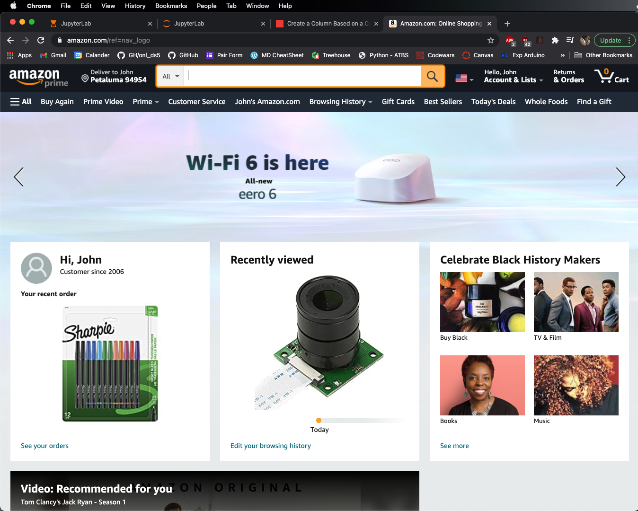

Slide 6
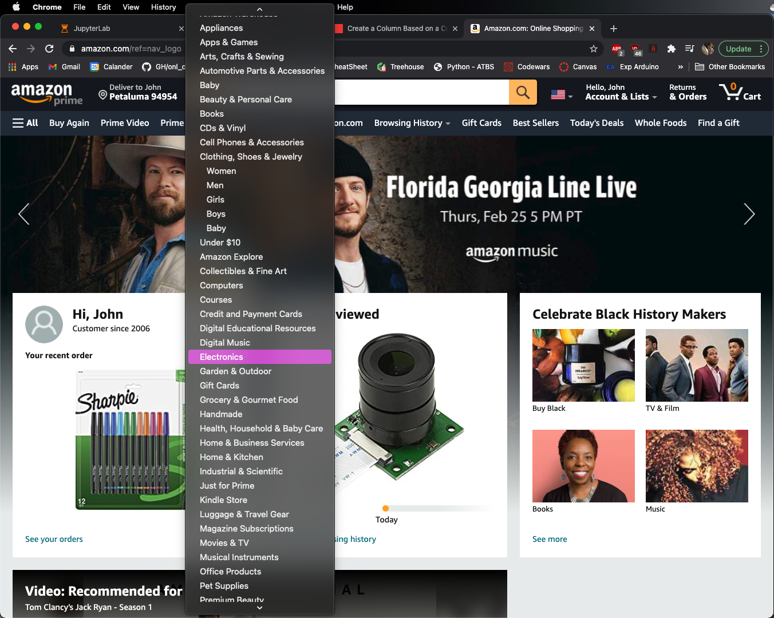

Slide 7
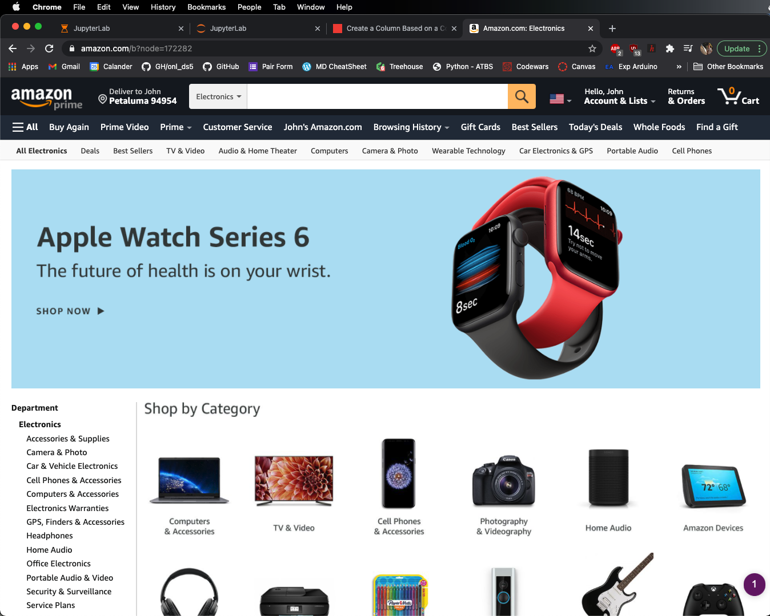
Categories!!

Slide 8
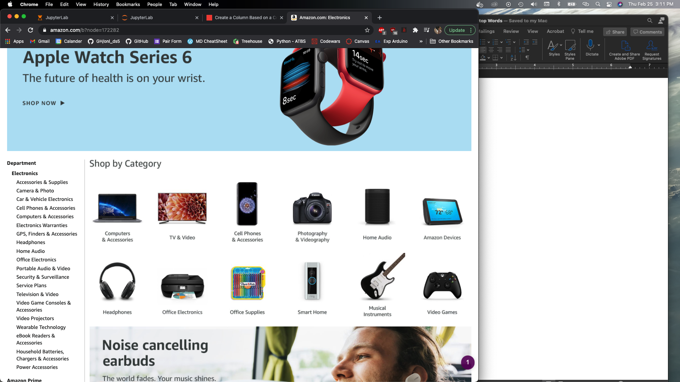

Slide 9
Categories!

Slide 10
Also categories?
Categories!

Slide 11
Stats

Slide 12
Stats
20,004,353 Reviews

Slide 13
Stats
20,004,353 Reviews
786,868 Products

Slide 14
Stats
20,004,353 Reviews
786,868 Products
May 1996-Oct 2018

Slide 15
Stats
20,004,353 Reviews
786,868 Products
May 1996-Oct 2018
Subsample
67,396 Reviews

Slide 16
Topic Modeling Time

Slide 17
Topic Modeling Time
Latent Dirichlet Analysis (LDA)

Slide 18
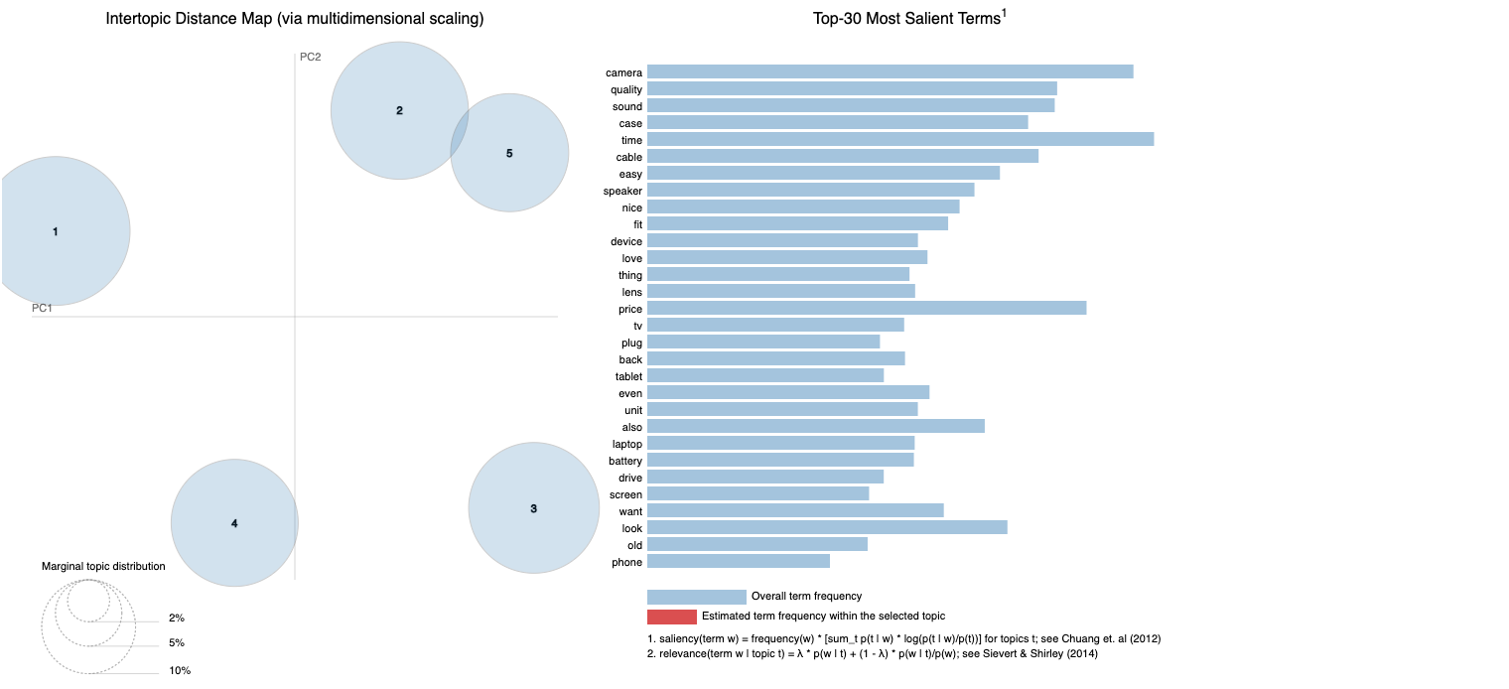

Slide 19
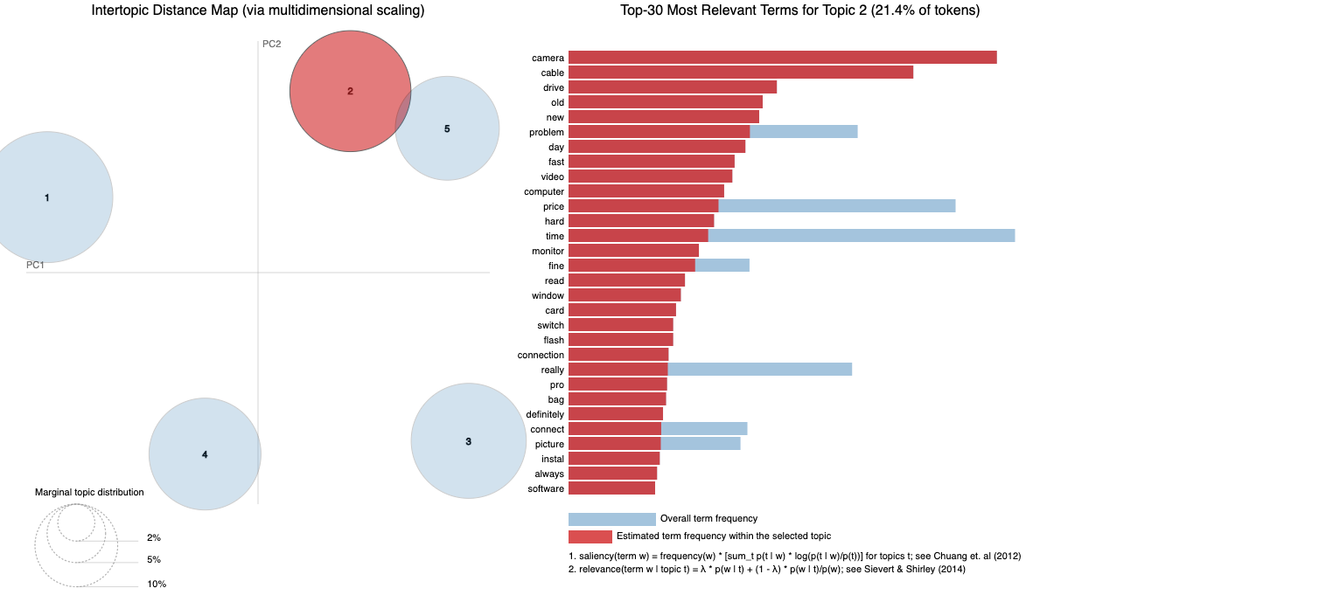
Camera

Slide 20
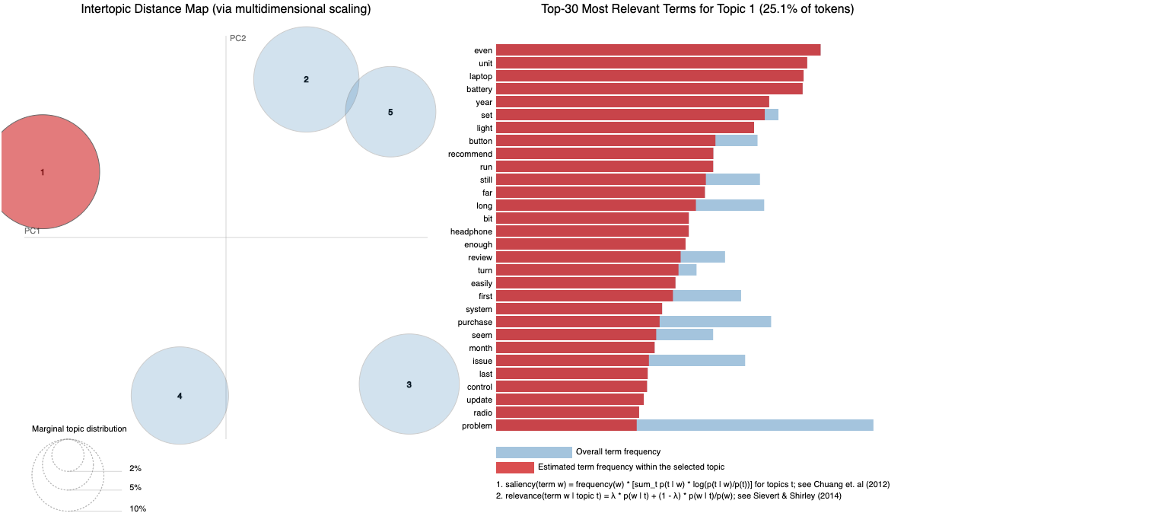
Laptop

Slide 21
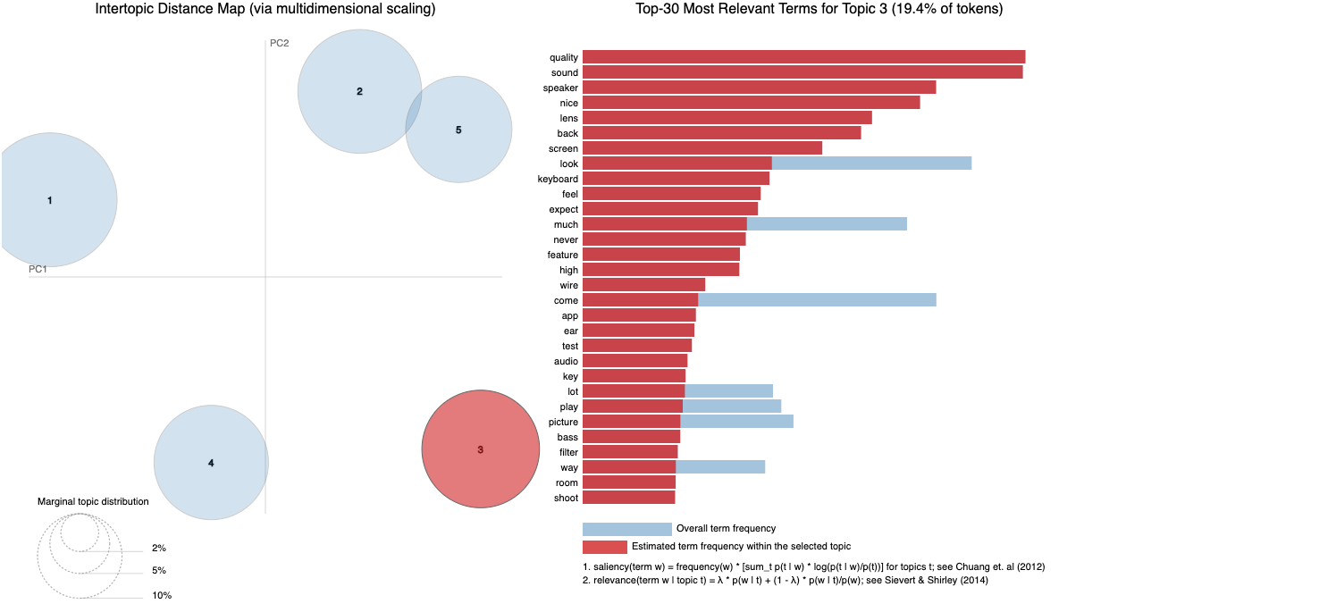
Sound

Slide 22
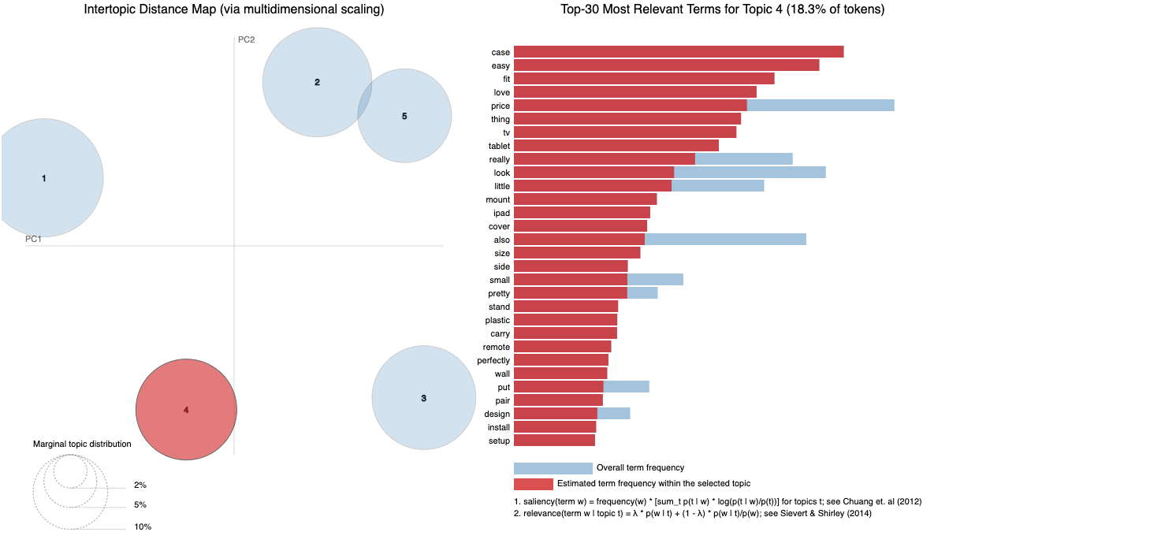
Tablet

Slide 23
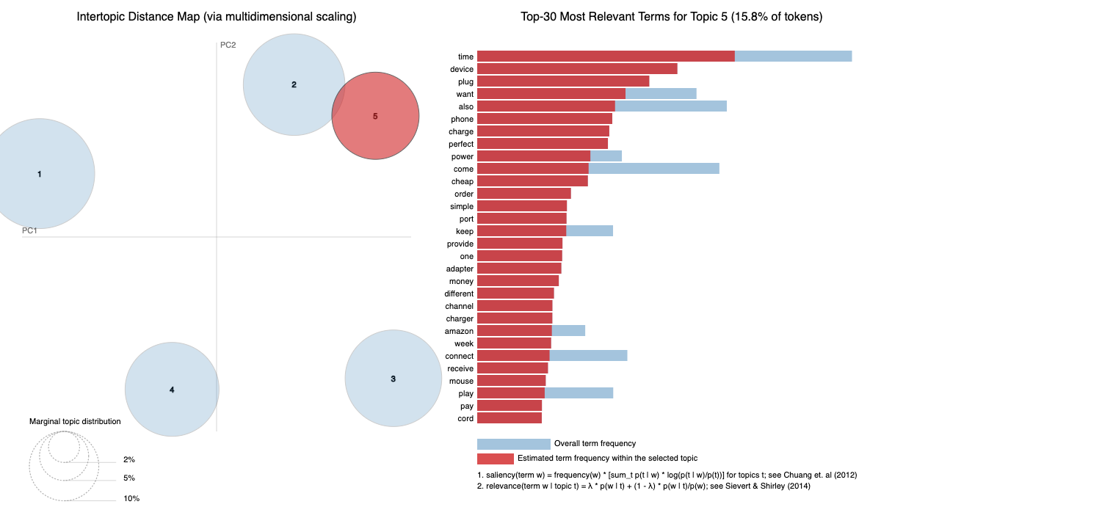
Miscellaneous Hardware

Slide 24
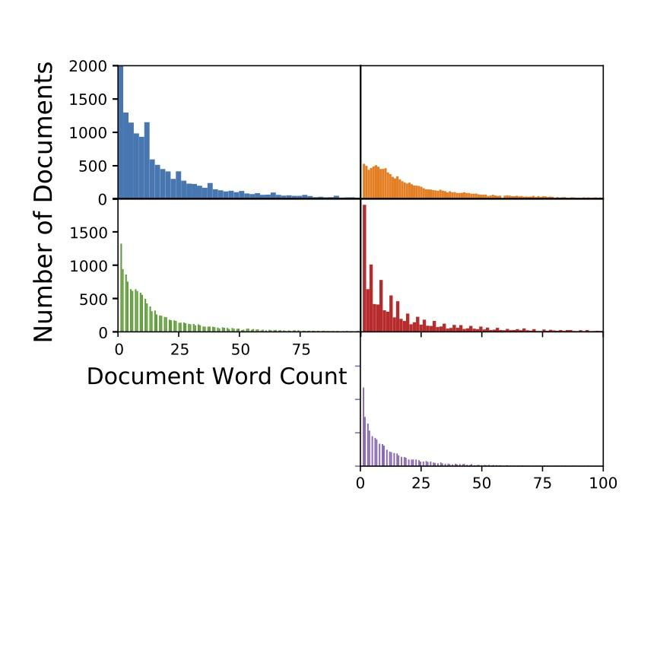
Topics

Slide 25
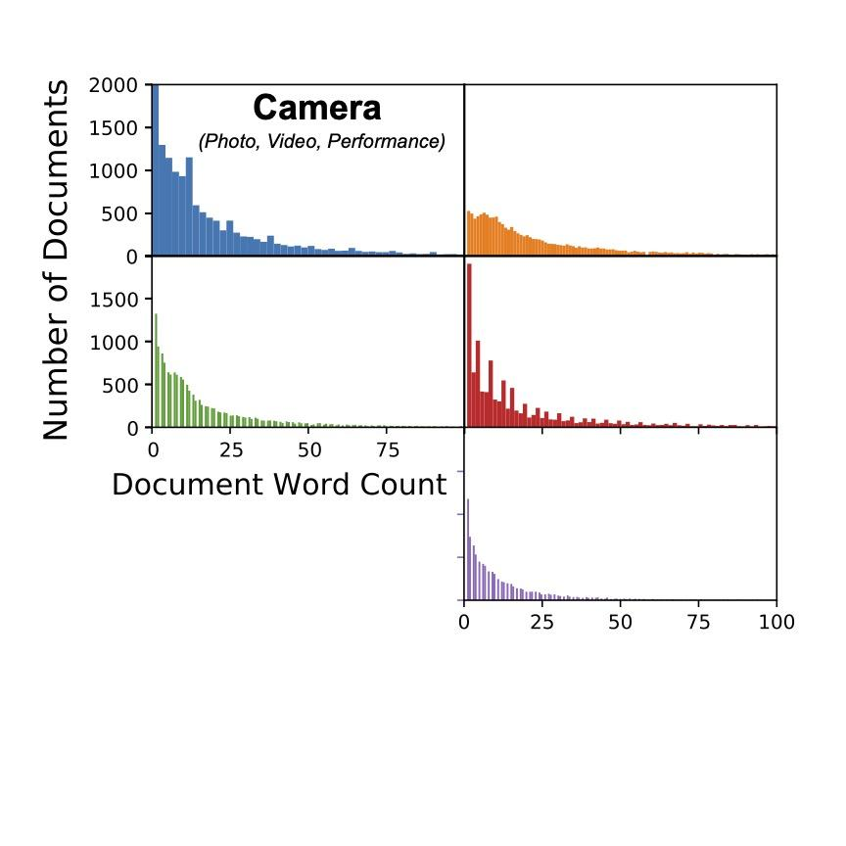
Topics
Camera
Performance
Hardware
Connectivity
Laptop
Hardware
Battery
Performance
Tablet
Ease of Use
Size
Sound (Earbuds, headphones, Speakers)
Speakers
Quality
Performance
Miscellaneous Hardware
Chargers
Time
Connectivity

Slide 26
Topics
Camera
Performance
Hardware
Connectivity
Laptop
Hardware
Battery
Performance
Tablet
Ease of Use
Size
Sound (Earbuds, headphones, Speakers)
Speakers
Quality
Performance
Miscellaneous Hardware
Chargers
Time
Connectivity

Slide 27
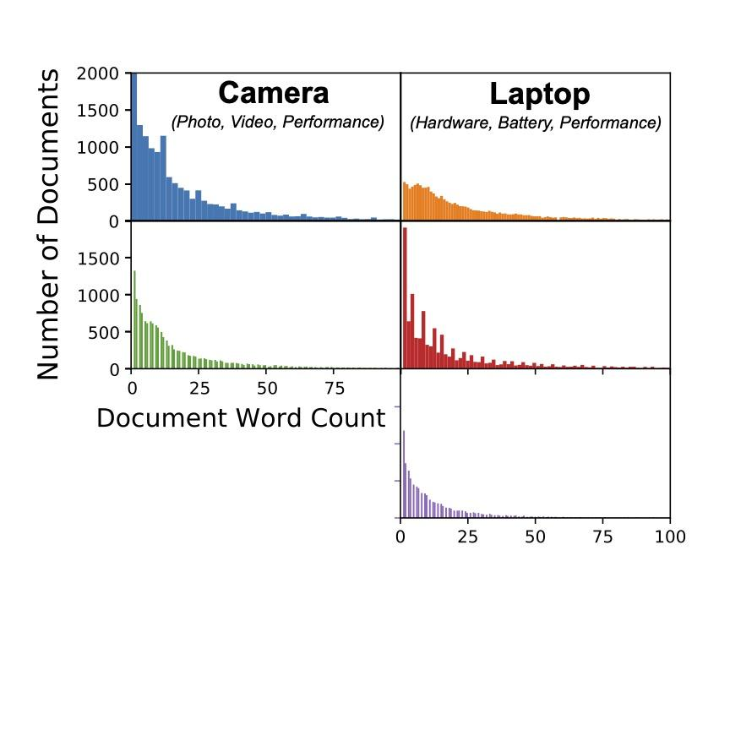
Topics
Camera
Performance
Hardware
Connectivity
Laptop
Hardware
Battery
Performance
Tablet
Ease of Use
Size
Sound (Earbuds, headphones, Speakers)
Speakers
Quality
Performance
Miscellaneous Hardware
Chargers
Time
Connectivity

Slide 28
Topics
Camera
Performance
Hardware
Connectivity
Laptop
Hardware
Battery
Performance
Tablet
Ease of Use
Size
Sound (Earbuds, headphones, Speakers)
Speakers
Quality
Performance
Miscellaneous Hardware
Chargers
Time
Connectivity

Slide 29
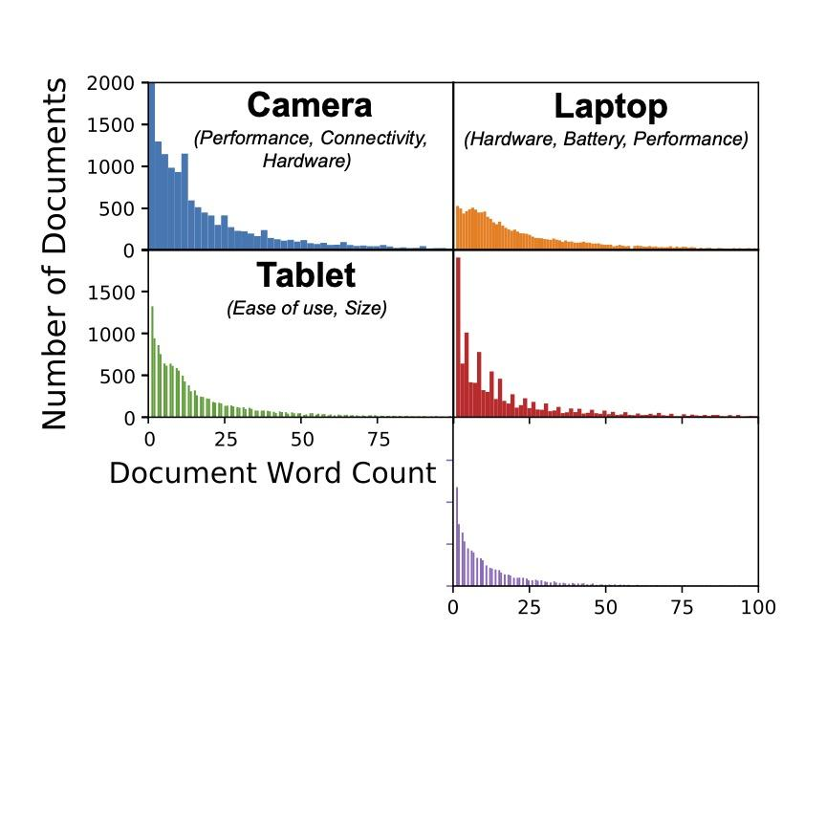
Topics
Camera
Performance
Hardware
Connectivity
Laptop
Hardware
Battery
Performance
Tablet
Ease of Use
Size
Sound (Earbuds, headphones, Speakers)
Speakers
Quality
Performance
Miscellaneous Hardware
Chargers
Time
Connectivity

Slide 30
Topics
Camera
Performance
Hardware
Connectivity
Laptop
Hardware
Battery
Performance
Tablet
Ease of Use
Size
Sound (Earbuds, headphones, Speakers)
Speakers
Quality
Performance
Miscellaneous Hardware
Chargers
Time
Connectivity

Slide 31
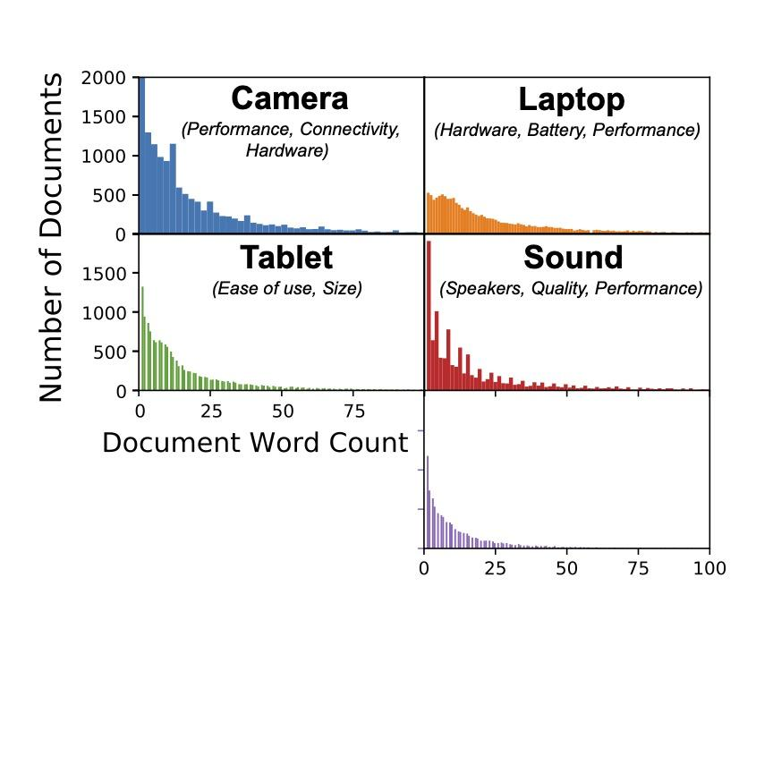
Topics
Camera
Performance
Hardware
Connectivity
Laptop
Hardware
Battery
Performance
Tablet
Ease of Use
Size
Sound (Earbuds, headphones, Speakers)
Speakers
Quality
Performance
Miscellaneous Hardware
Chargers
Time
Connectivity

Slide 32
Topics
Camera
Performance
Hardware
Connectivity
Laptop
Hardware
Battery
Performance
Tablet
Ease of Use
Size
Sound (Earbuds, headphones, Speakers)
Speakers
Quality
Performance
Miscellaneous Hardware
Chargers
Time
Connectivity

Slide 33
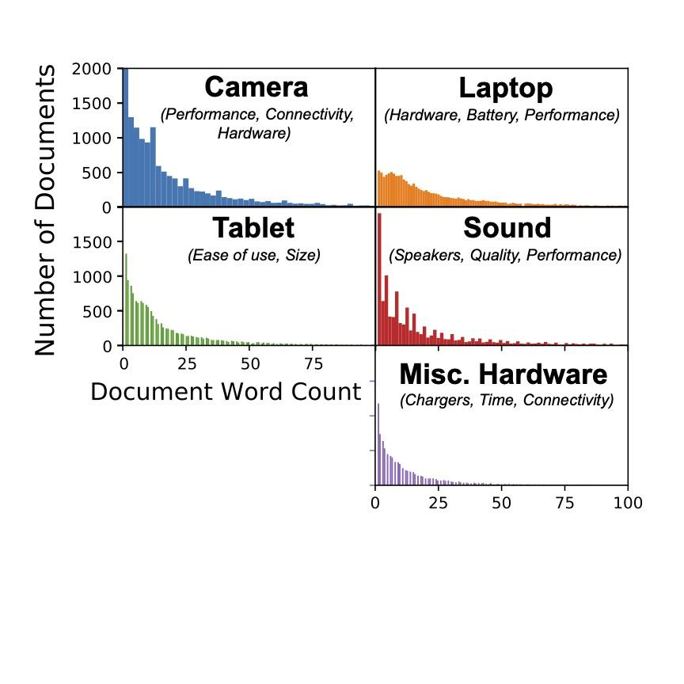
Topics
Camera
Performance
Hardware
Connectivity
Laptop
Hardware
Battery
Performance
Tablet
Ease of Use
Size
Sound (Earbuds, headphones, Speakers)
Speakers
Quality
Performance
Miscellaneous Hardware
Chargers
Time
Connectivity

Slide 34
Topics
Camera
Performance
Hardware
Connectivity
Laptop
Hardware
Battery
Performance
Tablet
Ease of Use
Size
Sound (Earbuds, headphones, Speakers)
Speakers
Quality
Performance
Miscellaneous Hardware
Chargers
Time
Connectivity

Slide 35
Topics
Camera
Performance
Hardware
Connectivity
Laptop
Hardware
Battery
Performance
Tablet
Ease of Use
Size
Sound (Earbuds, headphones, Speakers)
Speakers
Quality
Performance
Miscellaneous Hardware
Chargers
Time
Connectivity

Slide 36
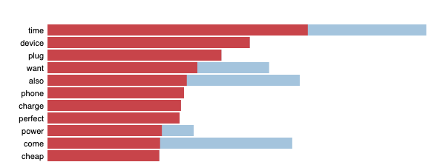
Topics
Camera
Performance
Hardware
Connectivity
Laptop
Hardware
Battery
Performance
Tablet
Ease of Use
Size
Sound (Earbuds, headphones, Speakers)
Speakers
Quality
Performance
Miscellaneous Hardware
Chargers
Time
Connectivity

Slide 37
Observations

Slide 38
Observations
Cameras come up no matter which model I was doing

Slide 39
Observations
Cameras come up no matter which model I was doing
Proper nouns showed up in Cameras and Misc. Hardware

Slide 40
Observations
Cameras come up no matter which model I was doing.
Proper nouns showed up in Cameras and Misc. Hardware
People give very specific reviews about the camera equipment?

Slide 41
Observations
Cameras come up no matter which model I was doing.
Proper nouns showed up in Cameras and Misc. Hardware
People give very specific reviews about the camera equipment?
Does this community leave similar reviews on other sites?

Slide 42
Observations
Cameras come up no matter which model I was doing.
Proper nouns showed up in Cameras and Misc. Hardware
People give very specific reviews about the camera equipment?
Does this community leave similar reviews on other sites?

Slide 43
How Does this compare to Amazon’s Categories?

Slide 45
Camera

Slide 46
Laptop
Camera

Slide 47
Laptop
Camera
?
Tablet

Slide 48
Laptop
Camera
Sound
?
Tablet

Slide 49
Laptop
Camera
Sound
Misc. Hardware
etc.
?
Tablet

Slide 50
What do we do with this information?

Slide 51
What do we do with this information?
Help Amazon organize their Electronic Categories suggestion algorithms

Slide 52

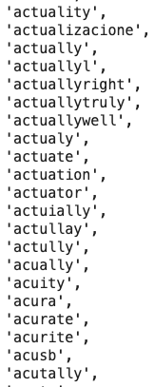
Amazon Reviewers:

Slide 53
But has this been noticed?

Slide 54
Laptop
Camera
Sound
Misc. Hardware
etc.
?
Tablet

Slide 55
Future Work

Slide 56
Future Work
Different Models and Libraries

Slide 57
Future Work
Different Models and Libraries
E.g., spaCy

Slide 58
Future Work
Different Models and Libraries
E.g., spaCy
Control for language

Slide 59
Future Work
Different Models and Libraries
E.g., spaCy
Control for language
Compare with other Departments

Slide 60
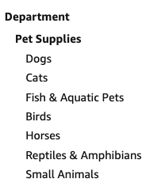
Future Work
Different Models and Libraries
E.g., spaCy
Control for language
Compare with other Departments

Slide 61





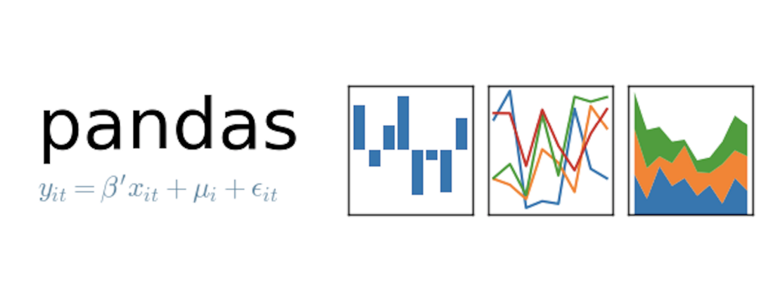
Thank You!
Sources
Tools Used
https://nijianmo.github.io/amazon/index.html
https://www.howtogeek.com/401209/how-to-safely-buy-photography-gear-online/

